Slide 1



Speech PREDICTIONS - ML using KEras -
03-Dec-2019
Group 6 : Rodolfo / Haitham / Ankur

Slide 2
Agenda
Problem Statement
Context - Audio Signal
Feature extraction from Speech
Model pipeline
Results (Speaker Recognition / Spoken Digit Recognition)
Conclusion
Industry Trends

Slide 3
Problem statement
Business Problem :
Biometric authentication using the speech dataset – Speaker Recognition (usage : Service Centers)
Inference of the digits as said by users on phone – Spoken Digit Recognition (usage : Navigate Menu or input digit datasets)

Slide 4
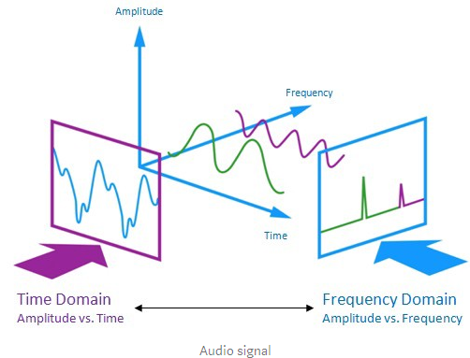
Context – Audio Signal
Audio signal is a three-dimensional signal in which three axes represent time, amplitude and frequency.
Problems :
“Ooonnnnneeeee” vs “One!”
Align audio files of various length to a fixed piece
Convert audio wave into set of numbers – record the height of wave at equally-spaced points.

Slide 5

Audio Wave Sampling – Converting wAVE to Numbers
Reading thousands of times a second and recording number representing the height of sound wave at that time
Speech recognition can be done at a sampling rate of 16Khz (16000 times per second
Here is an example of sample for “Hello”

Slide 6
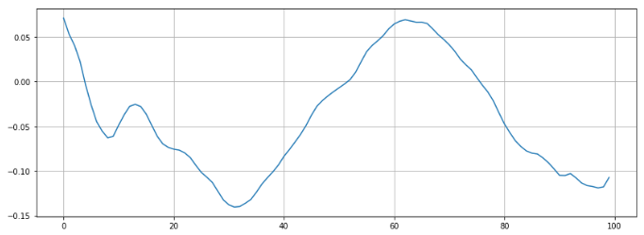
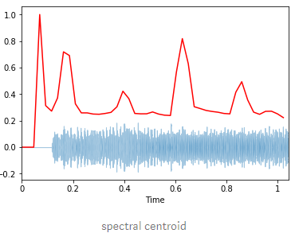
Feature Engineering
Energy / RMSE: The of a signal corresponds to the total magnitude of the signal and roughly corresponds to how loud the signal is. The energy in a signal is defined by ∑n|x(n)|2. The root mean square of this formula is called RMSE
Zero Crossing Rate : Rate of sign changes along a signal (ie the rate at which the signal changes from positive to negative or back.
Spectral Centroid : It indicates where the “center of mass” for a sound is located and is calculated as weighted mean of the frequencies present in the sound.
Zero Crossing Rate
Spectral centroid

Slide 7
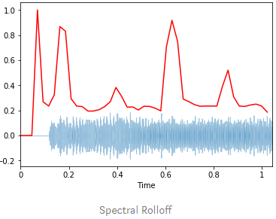
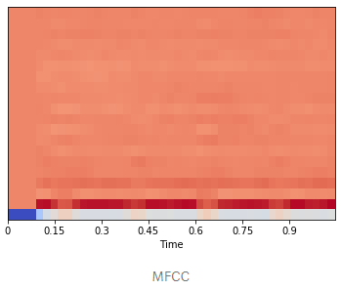
Feature engineering
Spectral Rolloff
Spectral Roll off : It’s the frequency below which a specified percentage of the total spectral energy, e.g. 85%, lies.
Chroma : It’s a typically 12-element feature vector indicating how much energy of each pitch class is present in the signal
Spectral Bandwidth : It’s the p'th-order spectral bandwidth.
MFCC (Mel-Frequency Cepstral Coefficients) : These are small set of features (usually about 10–20) which concisely describe the overall shape of a spectral envelope.
PS: It uses Fourier transform , to break apart the complex sound wave into the simple sound waves and then add up to get a sum of energy contained in each one.
MFCC

Slide 8
Model Pipeline – speaker recognition / SPOKEN DIGIT Recognition
Extract sound features
Preprocess and transform the dataset
Apply the Neural Network (Keras)
Tensorflow backend
Prediction
Calculate accuracy matrix

Slide 9
Data Preprocessing STEPs
Step 1: Sound features extraction using librosa
Step 2: Reading through the files in training set and appending to train matrix
Step 3: Data Classification and labelling
Step 4: Data Scaling of the feature set
Step 5: Divide the dataset into training, validation and test set

Slide 10
Neural Network Explained
Denselayer(256, relu)
Dropout(0.5)
Denselayer(128, relu)
Dropout(0.5)
Denselayer(64m relu)
Dropout(0.5)
Denselayer(10,softmax)

Slide 11
Test Data Explained
Experiment 1 : Got the speech dataset for 3 users (Jackson, Theo, Nicholas) for digits 0-9 repeated 49 different (training) and use the last one set as the test sample.
Experiment 2 : Got the speech dataset for 3 additional users (Ankur, Rodolfo, Caroline) for digits 0-9 (training) and use the another speech set as the test sample.

Slide 12
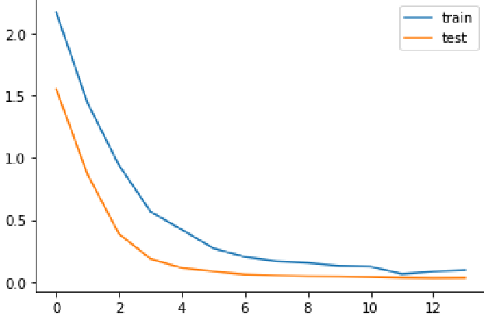
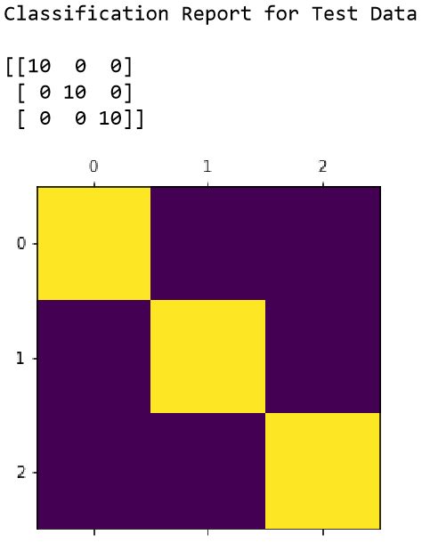
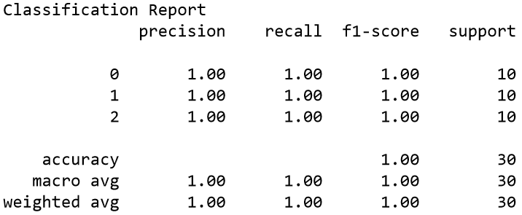
Model Results : SPEAKER Recognition EXp - 1
Train Data Set 1 : : (Jackson, Theo, Nicholas) 48 samples of each digit
Test Data 1: (Jackson, Theo, Nicholas) 49th recording
Accuracy : 100% (predict speaker)

Slide 13
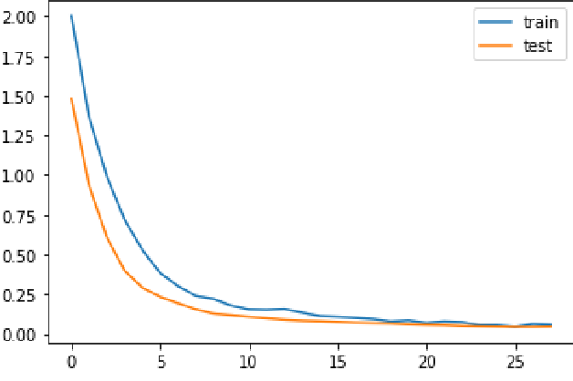
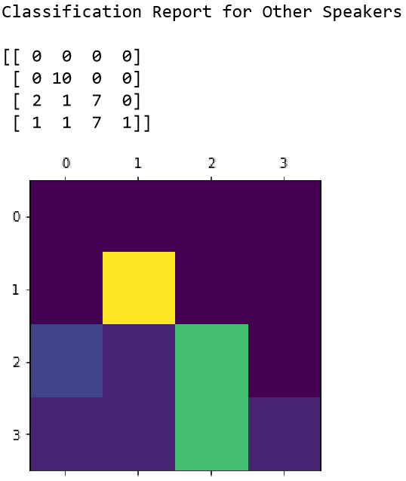
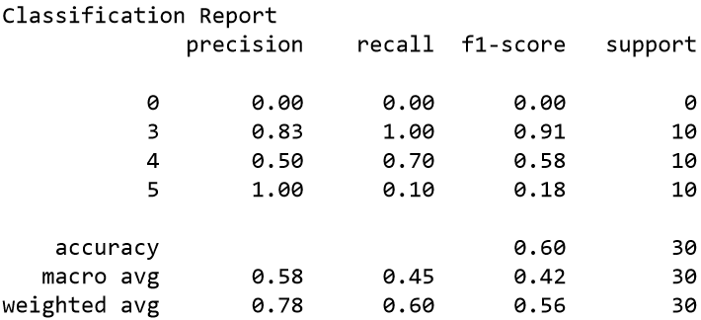
Model Results : Speaker Recognition Exp - 2
Train Data Set 2 : : (Jackson, Theo, Nicholas) 48 samples of each digit + (Ankur, Rodolfo, Caroline) 1 sample for each digit
Test Data 2: (Ankur, Rodolfo, Caroline) one recording
Accuracy : 60% (Predict speaker)

Slide 14
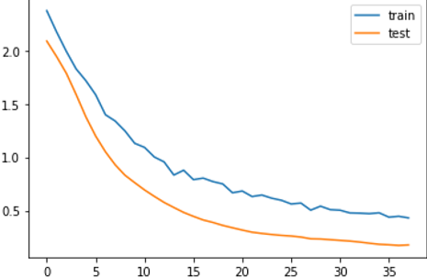
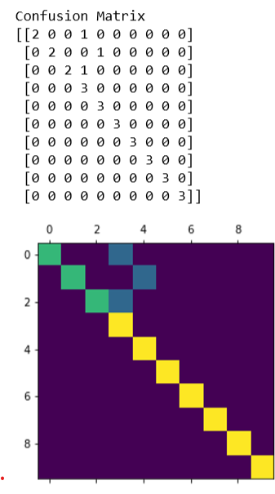
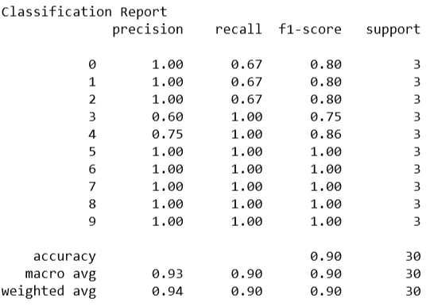
Model Results : Spoken Digit Recognition EXp - 1
Train Data Set 1 : : (Jackson, Theo, Nicholas) 48 samples of each digit
Test Data 1: (Jackson, Theo, Nicholas) 49th recording
Accuracy : 90% (predict digit from audio)

Slide 15
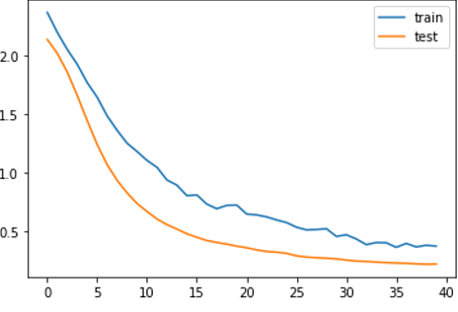
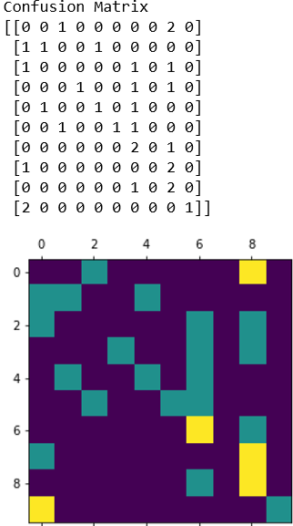
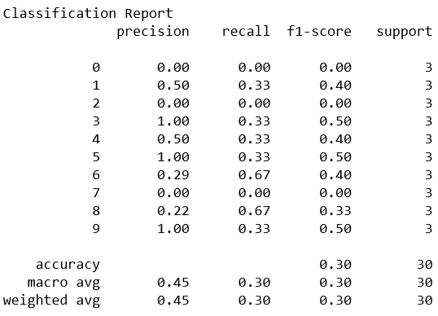
Model Results : Spoken Digit Recognition Exp - 2
Train Data Set 2 : : (Jackson, Theo, Nicholas) 48 samples of each digit + (Ankur, Rodolfo, Caroline) 1 sample for each digit
Test Data 2: (Ankur, Rodolfo, Caroline) one recording
Accuracy : 30% (predict digit from audio)

Slide 16
Conclusion
Neural networks can help predict both spoken digits and speaker to a great extent with an accuracy of more than 90%
Lots of training dataset is required in order to get a good working model.
The models fails to give good accuracy results for new speakers.
More noise signals
Ethnicity and origin of country can change the features of audio.
Possible Reasons:

Slide 17
Industry Trends
Good
Alexa / Siri / Google : Able to understand majority of our voice commands
Multifactor authentication includes some speech analysis to confirm user identity.
Bad
Privacy concerns around speech datasets and requirements to store a lot of datasets in order to predict correctly.
Increase in Voice Deepfakes attacks : https://www.forbes.com/sites/jessedamiani/2019/09/03/a-voice-deepfake-was-used-to-scam-a-ceo-out-of-243000/#1e4979a52241

Slide 18
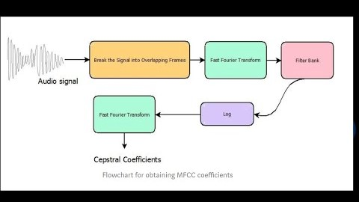
Project DEtails
Github location :
https://github.com/ravasconcelos/spoken-digits-recognition
Youtube video : https://www.youtube.com/watch?v=_FXqysbYVGs

